Slide 1
Chapter 4 & 5 – Architectural Design & Application Architecture

Slide 2
Topics covered
Architectural design decisions
Architectural views
Architectural patterns
Application architectures

Slide 9
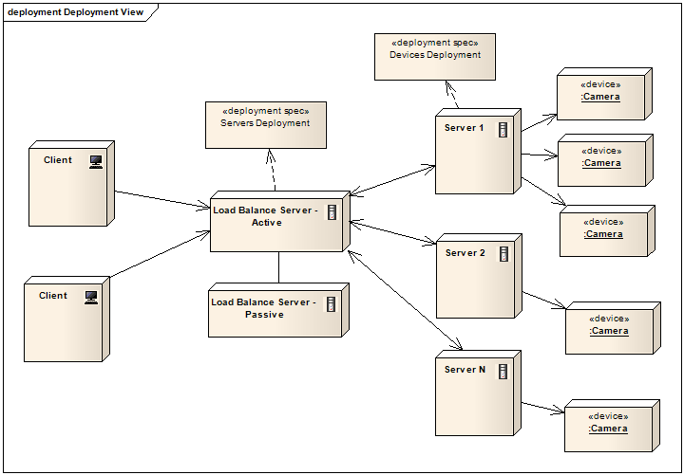

Slide 10
Architectural design
Architectural design is concerned with understanding how a software system should be organized and designing the overall structure of that system.
Architectural design is the critical link between design and requirements engineering, as it identifies the main structural components in a system and the relationships between them.
The output of the architectural design process is an architectural model that describes how the system is organized as a set of communicating components.

Slide 11
What is Software Architecture?
It’s about software design
All architecture is software design, but not all design is software architecture
Part of the design process
Simply, architecture focuses on ‘issues that will be difficult/impossible to change once the system is built’
Quality attributes like security, performance
Non-functional requirements like cost, deployment hardware
More on these later in this session

Slide 12
Definitions 1 - ANSI/IEEE Std 1471-2000
“Architecture is the fundamental organization of a system, embodied in its components, their relationships to each other and the environment, and the principles governing its design and evolution.”

Slide 13
Definitions 2 – SEI (Len Bass, Paul Clements, Rick Kazman)
“The software architecture of a program or computing system is the structure or structures of the system, which comprise software elements, the externally visible properties of those elements, and the relationships among them.”

Slide 14
Agility and architecture
It is generally accepted that an early stage of agile processes is to design an overall systems architecture.
Refactoring the system architecture is usually expensive because it affects so many components in the system

Slide 15
Architectural abstraction
Architecture in the small is concerned with the architecture of individual programs. At this level, we are concerned with the way that an individual program is decomposed into components.
Architecture in the large is concerned with the architecture of complex enterprise systems that include other systems, programs, and program components. These enterprise systems are distributed over different computers, which may be owned and managed by different companies.

Slide 16
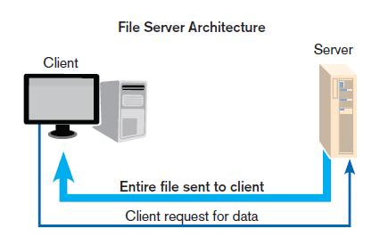
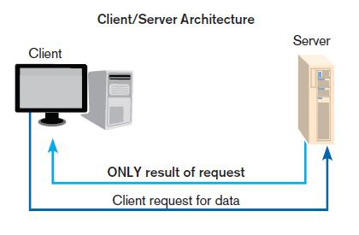
LAN-based file server architecture.

Slide 17
Limitations of File Servers
Excessive data movement
Entire data tables must be transferred instead of individual records.
Need for powerful client workstations
Each client workstation must devote memory to a full DBMS.
Decentralized data control
Complicates record concurrency control, recovery, and security.

Slide 18
Designing Systems for a Client/Server Architecture
Client/server architecture: a LAN-based computing environment in which central database server or engine performs all database commands sent to it from client workstations, and application programs on each client concentrate on user interface functions
Application processing is divided between client and server.
Client manages the user interface.
Database server is responsible for data storage and query processing.
Client: the (front-end) portion of the client/server database system that provides the user interface and data manipulation functions
Database engine: the (back-end) portion of the client/server database system running on the server that provides database processing and shared access functions

Slide 19
Advantages of explicit architecture
Stakeholder communication
Architecture may be used as a focus of discussion by system stakeholders.
System analysis
Means that analysis of whether the system can meet its non-functional requirements is possible.
Large-scale reuse
The architecture may be reusable across a range of systems
Product-line architectures may be developed.

Slide 20
Architectural representations
Simple, informal block diagrams showing entities and relationships are the most frequently used method for documenting software architectures.
But these have been criticised because they lack semantics, do not show the types of relationships between entities nor the visible properties of entities in the architecture.
Depends on the use of architectural models.The requirements for model semantics depends on how the models are used.

Slide 21
Box and line diagrams
Very abstract - they do not show the nature of component relationships nor the externally visible properties of the sub-systems.
However, useful for communication with stakeholders and for project planning.

Slide 22
Use of architectural models
As a way of facilitating discussion about the system design
A high-level architectural view of a system is useful for communication with system stakeholders and project planning because it is not cluttered with detail. Stakeholders can relate to it and understand an abstract view of the system. They can then discuss the system as a whole without being confused by detail.
As a way of documenting an architecture that has been designed
The aim here is to produce a complete system model that shows the different components in a system, their interfaces and their connections.

Slide 23
Architectural design decisions

Slide 24
Architectural design decisions
Architectural design is a creative process so the process differs depending on the type of system being developed.
However, a number of common decisions span all design processes and these decisions affect the non-functional characteristics of the system.

Slide 25
Architectural design decisions

Slide 26
Architecture reuse
Systems in the same domain often have similar architectures that reflect domain concepts.
Application product lines are built around a core architecture with variants that satisfy particular customer requirements.
The architecture of a system may be designed around one of more architectural patterns or ‘styles’.
These capture the essence of an architecture and can be instantiated in different ways.

Slide 27
Architecture and system characteristics
Performance
Localise critical operations and minimise communications. Use large rather than fine-grain components.
Security
Use a layered architecture with critical assets in the inner layers.
Safety
Localise safety-critical features in a small number of sub-systems.
Availability
Include redundant components and mechanisms for fault tolerance.
Maintainability
Use fine-grain, replaceable components.

Slide 28
Architectural views

Slide 29
Architectural views
What views or perspectives are useful when designing and documenting a system’s architecture?
What notations should be used for describing architectural models?
Each architectural model only shows one view or perspective of the system.
It might show how a system is decomposed into modules, how the run-time processes interact or the different ways in which system components are distributed across a network. For both design and documentation, you usually need to present multiple views of the software architecture.

Slide 30
Physiological Structures
The neurologist, the orthopedist, the hematologist, and the dermatologist all have different views of the structure of a human body.
Ophthalmologists, cardiologists, and podiatrists concentrate on specific subsystems.
The kinesiologist and psychiatrist are concerned with different aspects of the entire arrangement’s behavior.
Although these views are pictured differently and have different properties, all are inherently related, interconnected.
Together they describe the architecture of the human body.
So it is with software!

Slide 31
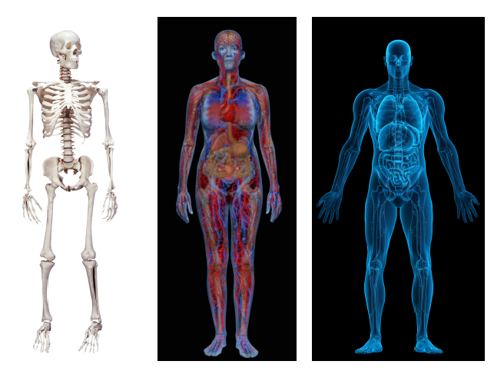
Physiological Structures

Slide 32
Architectural views

Slide 33
Philippe Krutchen – 4 + 1 view model of software architecture
A logical view, which shows the key abstractions in the system as objects or object classes.
A process view, which shows how, at run-time, the system is composed of interacting processes.
A development view, which shows how the software is decomposed for development.
A physical view, which shows the system hardware and how software components are distributed across the processors in the system.
Related using use cases or scenarios (+1)
(e.g. class diagrams, object diagrams, state charts, and composite structures)
(e.g. sequence diagrams, communication diagrams, activity diagrams, timing diagrams, interaction overview diagrams)
(e.g. deployment diagram)
(e.g. component diagrams)
(e.g. use case diagram, activity diagrams)

Slide 34
Representing architectural views
Some people argue that the Unified Modeling Language (UML) is an appropriate notation for describing and documenting system architectures
I disagree with this as I do not think that the UML includes abstractions appropriate for high-level system description.
Architectural description languages (ADLs) have been developed but are not widely used

Slide 35
Quality Attributes

Slide 37
Architecture, and Quality Attributes
Ex: Performance depends partially on
how much communication is necessary among components (Arch)
what functionality has been allocated to each component (Arch)
how shared resources are allocated (Arch)
the choice of algorithms to implement selected functionality (Non-arch)
how these algorithms are coded (Non-arch)

Slide 38
What are Quality Attributes
Often know as –ilities
Performance (!)
Scalability
Availability (related to Reliability)
Security (!)
Modifiability (related to Reusability)
Integration (!)
Portability
Etc.

Slide 39
Performance
Many examples of poor performance in enterprise applications
Performance requires a:
Metric of amount of work performed in unit time
Deadline that must be met
Enterprise applications often have strict performance requirements, e.g.
1000 transactions per second
3 second average latency for a request

Slide 40
1. Performance - Throughput
Measure of the amount of work an application must perform in unit time
Transactions per second (tps)
Messages per minute (mps)
Is required throughput:
Average? (e.g. business day)
Peak?
Many system have low average but high peak throughput requirements

Slide 41
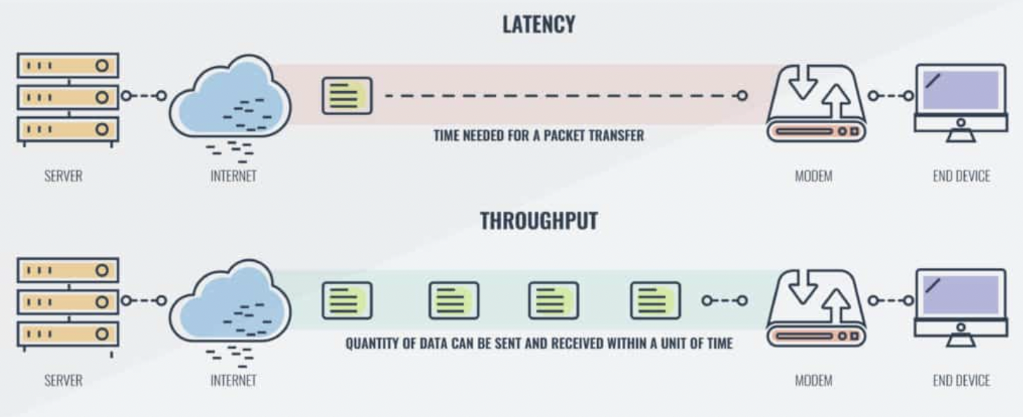
Latency – The time taken for a packet to be transferred across a network. You can measure this as one-way to its destination or as a round trip. latency is a measure of delay
Throughput – The quantity of data being sent and received within a unit of time

Slide 42
2. Performance - Response Time
Measure of the latency an application exhibits in processing a request
Usually measured in (milli)seconds
Often an important metric for users
Is required response time:
Guaranteed? (all request to be served within a specified time limit)
Average? (larger latencies)
E.g. 95% of responses in sub-4 seconds, and all within 10 seconds
E.g. 95% of all requests must be processed in less than four seconds and no requests must take more than 15 seconds

Slide 43
3. Performance - Deadlines
‘something must be completed before some specified time’
Payroll system must complete by 2am so that electronic transfers can be sent to bank
Weekly accounting run must complete by 6am Monday so that figures are available to management
Deadlines often associated with batch jobs in IT systems.

Slide 44
Something to watch for …
What is a
Transaction?
Message?
Request?
All are application specific measures.
System must achieve 100 mps throughput
BAD!!
System must achieve 100 mps peak throughput for PaymentReceived messages
GOOD!!!

Slide 45
Scalability
“How well a solution to some problem will work when the size of the problem increases.” - How a design can cope with some aspect of the application’s requirements increasing in size
4 common scalability issues in IT systems:
Request load
Connections
Data size
Deployments

Slide 46
1. Scalability – Request Load
How does an 100 tps application behave when simultaneous request load grows? E.g.
From 100 to 1000 requests per second?
Ideal solution, without additional hardware capacity:
as the load increases, throughput remains constant (i.e. 100 tps), and response time per request increases only linearly (i.e. 10 seconds).

Slide 47
Scalability – Add more hardware …
Scale-up:
Single application instance is executed on a multiprocessor machine
Application
Scale-out: Application replicated on different machines
Application
CPU
Application
Application
Application

Slide 48
2. Scalability - connections
What happens if number of simultaneous connections to an application increases
If each connection consumes a resource?
Exceed maximum number of connections?
ISP example:
Each user connection spawned a new process
Virtual memory on each server exceeded at 2000 users
Needed to support 100Ks of users
Tech crash ….

Slide 49
3. Scalability – Data Size
How does an application behave as the data it processes increases in size?
Chat application sees average message size double?
Database table size grows from 1 million to 20 million rows?
Image analysis algorithm processes images of 100MB instead of 1MB?
Can application/algorithms scale to handle increased data requirements?

Slide 50
4. Scalability - Deployment
How does effort to install/deploy an application increase as installation base grows?
Install new users?
Install new servers?
Solutions typically revolve around automatic download/installation
E.g. downloading applications from the Internet

Slide 51
Security
Difficult, specialized quality attribute:
Lots of technology available
Requires deep knowledge of approaches and solutions
Security is a multi-faceted quality …

Slide 52
Security (cont.)
Authentication: Applications can verify the identity of their users and other applications with which they communicate.
Authorization: Authenticated users and applications have defined access rights to the resources of the system.
Encryption: The messages sent to/from the application are encrypted.
Integrity: This ensures the contents of a message are not altered in transit.
Non-repudiation: The sender of a message has proof of delivery and the receiver is assured of the sender’s identity. This means neither can subsequently refute their participation in the message exchange.

Slide 53
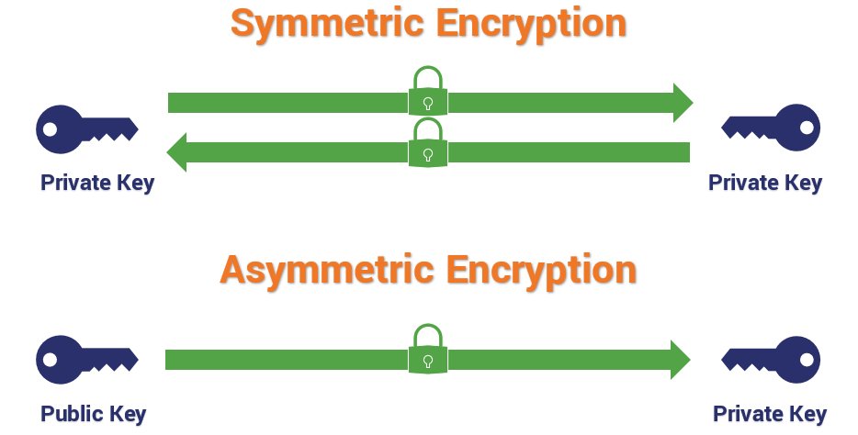
Security Approaches
SSL – Secure Sockets Layer
PKI – Public Key Infrastructure
Web Services security
JAAS – Java Authentication and Authorization Service
Operating system security
Database security
Etc

Slide 54
Availability
Key requirement for most IT applications
Measured by the proportion of the required time it is useable. E.g.
100% available during business hours
No more than 2 hours scheduled downtime per week
24x7x52 (100% availability)
Related to an application’s reliability
Unreliable applications suffer poor availability

Slide 55
Availability
Period of loss of availability determined by:
Time to detect failure
Time to correct failure
Time to restart application
Strategies for high availability:
Eliminate single points of failure
Replication and failover
Automatic detection and restart
Recoverability (e.g. a database)
the capability to reestablish performance levels and recover affected data after an application or system failure

Slide 56
Integration
ease with which an application can be incorporated into a broader application context
Use component in ways that the designer did not originally anticipate
Typically achieved by:
Programmatic APIs
Data integration

Slide 57
Integration Strategies
Data – expose application data for access by other components
API – offers services to read/write application data through an abstracted interface
Each has strengths and weaknesses …
Interoperability through an API facade
Application
API
Third Party Application
Data
Interoperability achieved by direct data access

Slide 58
Architectural Patterns & Styles

Slide 59
Choosing the Architecture
Choose an architecture patterns/styles that suit requirements
No magic formula
Analyze requirements and quality attributed supported by each pattern
Complex architectures require creative blending of multiple patterns.

Slide 60
Architectural Patterns
Patterns are a means of representing, sharing and reusing knowledge.
An architectural pattern is a stylized description of good design practice, which has been tried and tested in different environments.
Patterns should include information about when they are and when the are not useful.
Patterns may be represented using tabular and graphical descriptions.

Slide 61
Architectural Styles
An architectural style is a named collection of architectural design decisions that
are applicable in a given development context
constrain architectural design decisions that are specific to a particular system within that context
elicit beneficial qualities in each resulting system
A primary way of characterizing lessons from experience in software system design
Reflect less domain specificity than architectural patterns
Useful in determining everything from subroutine structure to top-level application structure

Slide 62
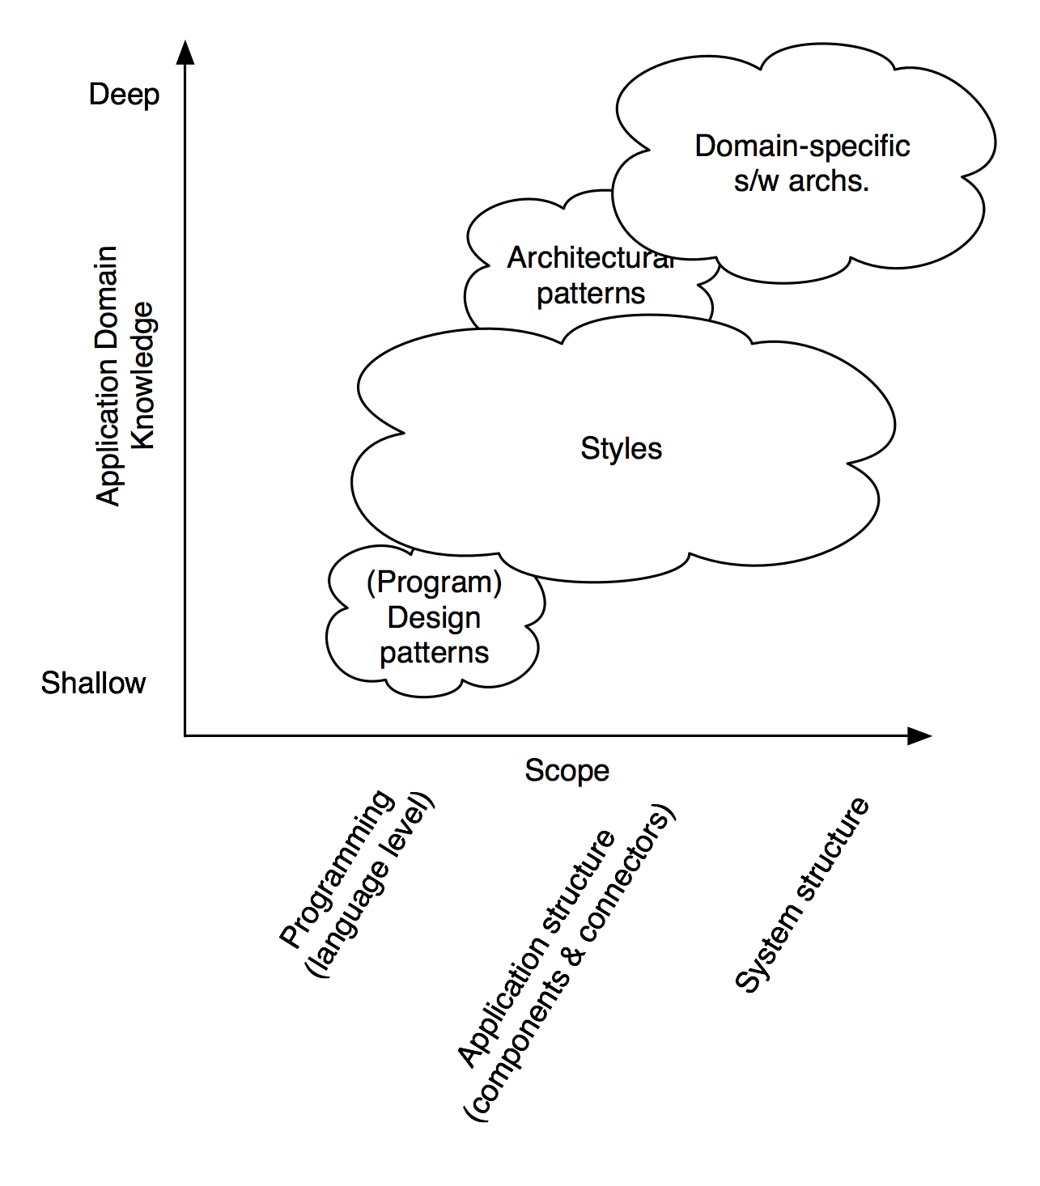
Patterns and Styles
Software Architecture: Foundations, Theory, and Practice; Richard N. Taylor, Nenad Medvidovic, and Eric M. Dashofy; © 2008 John Wiley & Sons, Inc. Reprinted with permission.

Slide 63
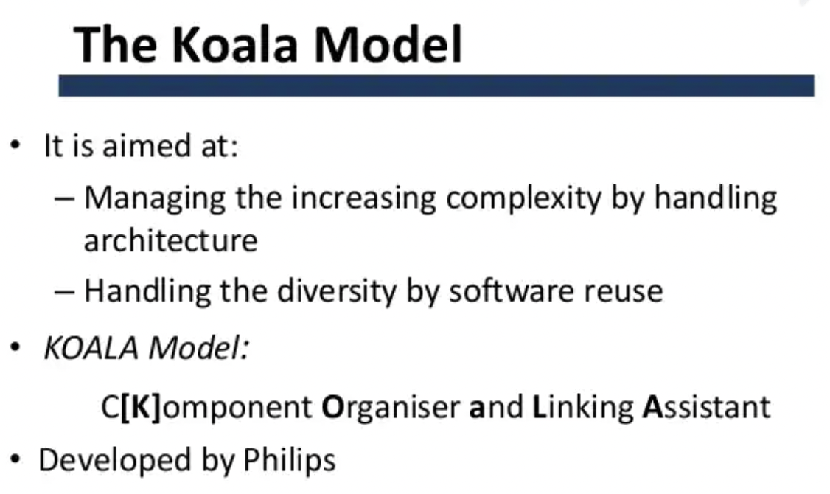
Some Common Styles
Basic” styles
Pipe and filter
Object-oriented
Layered
Blackboard
State transition
Client-server
Peer-to-peer
Event-based (a.k.a. Implicit invocation)
Publish-Subscribe
Mobile-code
“Derived” styles
Koala

Slide 64
Benefits of Using Styles
Design reuse
Well-understood solutions applied to new problems
Code reuse
Shared implementations of invariant aspects of a style
Understandability of system organization
A phrase such as “client-server” conveys a lot of information
Interoperability
Supported by style standardization
Style-specific analyses
Enabled by the constrained design space
Visualizations
Style-specific depictions matching engineers’ mental models

Slide 65
Basic Properties of Patterns/Styles
A vocabulary of design elements
Component and connector types; data elements
e.g., pipes, filters, objects, servers
A set of configuration rules
Topological constraints that determine allowed compositions of elements
e.g., a component may be connected to at most two other components
A semantic interpretation
Compositions of design elements have well-defined meanings
Possible analyses of systems built in a style

Slide 66
Example: The Model-View-Controller (MVC) pattern
Name | MVC (Model-View-Controller)
Description | Separates presentation and interaction from the system data. The system is structured into three logical components that interact with each other. The Model component manages the system data and associated operations on that data. The View component defines and manages how the data is presented to the user. The Controller component manages user interaction (e.g., key presses, mouse clicks, etc.) and passes these interactions to the View and the Model. See Figure 6.3.
Example | Figure 6.4 shows the architecture of a web-based application system organized using the MVC pattern.
When used | Used when there are multiple ways to view and interact with data. Also used when the future requirements for interaction and presentation of data are unknown.
Advantages | Allows the data to change independently of its representation and vice versa. Supports presentation of the same data in different ways with changes made in one representation shown in all of them.
Disadvantages | Can involve additional code and code complexity when the data model and interactions are simple.

Slide 67
The organization of the Model-View-Controller

Slide 68
Web application architecture using the MVC pattern

Slide 69
MVC-Based Web Application Frameworks
.NET
ASP.NET MVC, MonoRail
Java
JavaServer Faces (JSF), Struts, Spring Web MVC, Tapestry, JBoss Seam, Swing
PHP
CakePHP, Symfony, Zend, Joomla, Yii, Mojavi
Python
Django, Zope Application Server, TurboGears
Ruby on Rails
Ruby on Rails

Slide 70
Example 1: The Client–server
Name | Client-server
Description | In a client–server architecture, the functionality of the system is organized into services, with each service delivered from a separate server. Clients are users of these services and access servers to make use of them.
Example | Figure 6.11 is an example of a film and video/DVD library organized as a client–server system.
When used | Used when data in a shared database has to be accessed from a range of locations. Because servers can be replicated, may also be used when the load on a system is variable.
Advantages | The principal advantage of this model is that servers can be distributed across a network. General functionality (e.g., a printing service) can be available to all clients and does not need to be implemented by all services.
Disadvantages | Each service is a single point of failure so susceptible to denial of service attacks or server failure. Performance may be unpredictable because it depends on the network as well as the system. May be management problems if servers are owned by different organizations.

Slide 71
Client-server architecture
Distributed system model which shows how data and processing is distributed across a range of components.
Can be implemented on a single computer.
Set of stand-alone servers which provide specific services such as printing, data management, etc.
Set of clients which call on these services.
Network which allows clients to access servers.

Slide 72
Extension from Client-Server: N-Tier (Multi-Tier) Client Server Style
Separation of concerns: Presentation, business and data handling logic are clearly partitioned in different tiers.
Synchronous communications: Communications between tiers is synchronous request-reply. Each tier waits for a response from the other tier before proceeding.
Flexible deployment: There are no restrictions on how a multi-tier application is deployed. All tiers could run on the same machine, or each tier may be deployed on its own machine.
Client
Tier
Web
Client
Web
Client
Web
Client
Web Server
Tier
Web Server
Business Logic Tier
Application Server
Data
Management Tier
Databases

Slide 73





The 3-Tier Architecture Model
Data Tier
(Back-End)
Middle Tier
(Business Tier)
Client Tier (Front-End)
Client
Machine
network
network
Mobile
Client
network
Database
Business
Logic
Desktop
Client

Slide 74
N-Tier Client Server – Quality Attribute Analysis
Quality Attribute | Issues
Availability | Servers in each tier can be replicated, so that if one fails, others remain available. Overall the application will provide a lower quality of service until the failed server is restored.
Failure handling | If a client is communicating with a server that fails, most web and application servers implement transparent failover. This means a client request is, without its knowledge, redirected to a live replica server that can satisfy the request.
Modifiability | Separation of concerns enhances modifiability, as the presentation, business and data management logic are all clearly encapsulated. Each can have its internal logic modified in many cases without changes rippling into other tiers.
Performance | This architecture has proven high performance. Key issues to consider are the amount of concurrent threads supported in each server, the speed of connections between tiers and the amount of data that is transferred. As always with distributed systems, it makes sense to minimize the calls needed between tiers to fulfill each request.
Scalability | As servers in each tier can be replicated, and multiple server instances run on the same or different servers, the architecture scales out and up well. In practice, the data management tier often becomes a bottleneck on the capacity of a system.

Slide 75
Example 2: Layered architecture
Used to model the interfacing of sub-systems.
Organises the system into a set of layers (or abstract machines) each of which provide a set of services.
Supports the incremental development of sub-systems in different layers. When a layer interface changes, only the adjacent layer is affected.
However, often artificial to structure systems in this way.

Slide 76
The Layered architecture
Name | Layered architecture
Description | Organizes the system into layers with related functionality associated with each layer. A layer provides services to the layer above it so the lowest-level layers represent core services that are likely to be used throughout the system. See Figure 6.6.
Example | A layered model of a system for sharing copyright documents held in different libraries, as shown in Figure 6.7.
When used | Used when building new facilities on top of existing systems; when the development is spread across several teams with each team responsibility for a layer of functionality; when there is a requirement for multi-level security.
Advantages | Allows replacement of entire layers so long as the interface is maintained. Redundant facilities (e.g., authentication) can be provided in each layer to increase the dependability of the system.
Disadvantages | In practice, providing a clean separation between layers is often difficult and a high-level layer may have to interact directly with lower-level layers rather than through the layer immediately below it. Performance can be a problem because of multiple levels of interpretation of a service request as it is processed at each layer.

Slide 77
A generic layered architecture

Slide 78
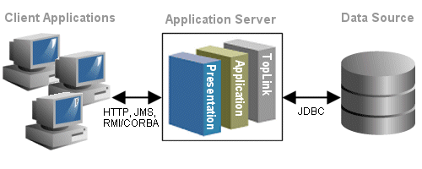
Classical Layered Structure of Software Systems

Slide 79
The architecture of the iLearn system

Slide 80
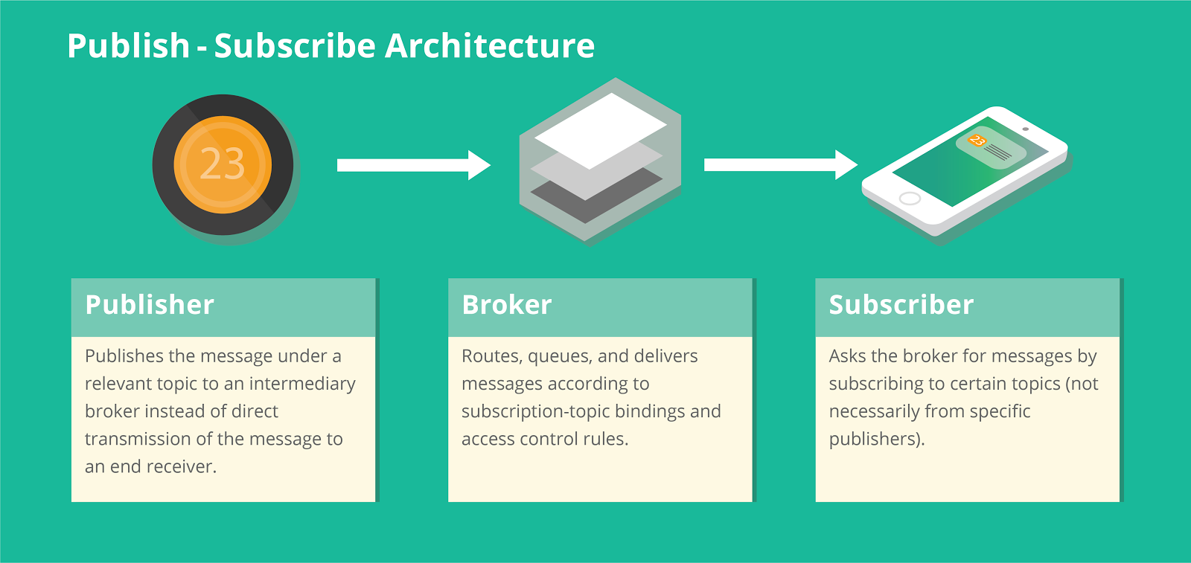
Example 3: Publish-Subscribe Style
In software architecture, publish–subscribe is a messaging style where senders of messages, called publishers, do not program the messages to be sent directly to specific receivers, called subscribers, but instead categorize published messages into classes without knowledge of which subscribers, if any, there may be. Similarly, subscribers express interest in one or more classes and only receive messages that are of interest, without knowledge of which publishers, if any, there are.
Subscribers register/deregister to receive specific messages or specific content. Publishers broadcast messages to subscribers either synchronously or asynchronously.

Slide 81
Publish-Subscribe Style (cont.)
Components: Publishers, subscribers, proxies for managing distribution (broker)
Connectors: Typically a network protocol is required. Content-based subscription requires sophisticated connectors.
Data Elements: Subscriptions, notifications, published information
Topology: Subscribers connect to publishers either directly or may receive notifications via a network protocol from intermediaries

Slide 83
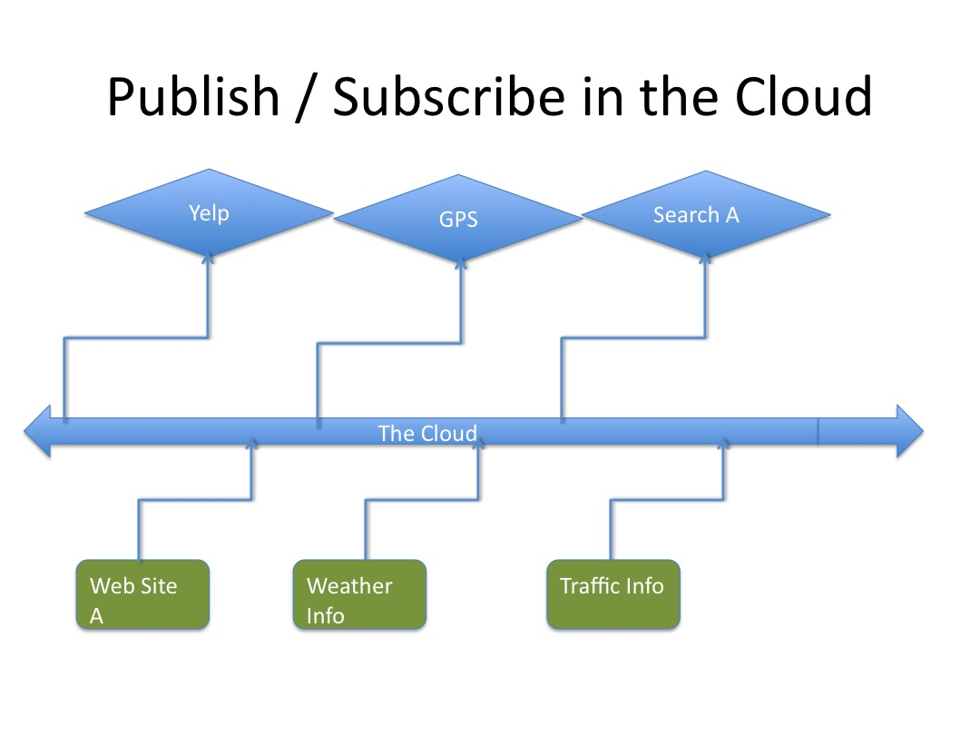
Pubs-Subs Example

Slide 84
Consequences – Pros
Loose coupling. The publisher is not aware of the number of subscribers, of the identities of the subscribers, or of the message types that the subscribers are subscribed to.
Improved security. The communication infrastructure transports the published messages only to the applications that are subscribed to the corresponding topic. Specific applications can exchange messages directly, excluding other applications from the message exchange.
Improved testability. Topics usually reduce the number of messages that are required for testing.
Scalability. Pub/sub provides the opportunity for better scalability than traditional client-server, through parallel operation, message caching, tree-based or network-based routing, etc.

Slide 85
Consequences – Cons
Increased complexity. Publish/Subscribe requires you to address the following:
You have to design a message classification scheme for topic implementation.
You have to implement the subscription mechanism.
You have to modify the publisher and the subscribers.
Increased maintenance effort. Managing topics requires maintenance work. Organizations that maintain many topics usually have formal procedures for their use.
Decreased performance. Subscription management adds overhead. This overhead increases the latency of message exchange, and this latency decreases performance.

Slide 86
Example 4: Repository architecture
Sub-systems must exchange data. This may be done in two ways:
Shared data is held in a central database or repository and may be accessed by all sub-systems;
Each sub-system maintains its own database and passes data explicitly to other sub-systems.
When large amounts of data are to be shared, the repository model of sharing is most commonly used a this is an efficient data sharing mechanism.

Slide 87
The Repository pattern
Name | Repository
Description | All data in a system is managed in a central repository that is accessible to all system components. Components do not interact directly, only through the repository.
Example | Figure 6.9 is an example of an IDE where the components use a repository of system design information. Each software tool generates information which is then available for use by other tools.
When used | You should use this pattern when you have a system in which large volumes of information are generated that has to be stored for a long time. You may also use it in data-driven systems where the inclusion of data in the repository triggers an action or tool.
Advantages | Components can be independent—they do not need to know of the existence of other components. Changes made by one component can be propagated to all components. All data can be managed consistently (e.g., backups done at the same time) as it is all in one place.
Disadvantages | The repository is a single point of failure so problems in the repository affect the whole system. May be inefficiencies in organizing all communication through the repository. Distributing the repository across several computers may be difficult.

Slide 88
A repository architecture for an IDE

Slide 89
Application architectures

Slide 90
Application architectures
Application systems are designed to meet an organisational need.
As businesses have much in common, their application systems also tend to have a common architecture that reflects the application requirements.
A generic application architecture is an architecture for a type of software system that may be configured and adapted to create a system that meets specific requirements.

Slide 91
Use of application architectures
As a starting point for architectural design.
As a design checklist.
As a way of organising the work of the development team.
As a means of assessing components for reuse.
As a vocabulary for talking about application types.

Slide 92
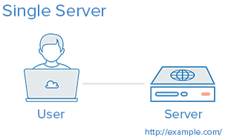
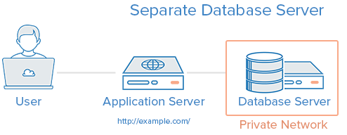
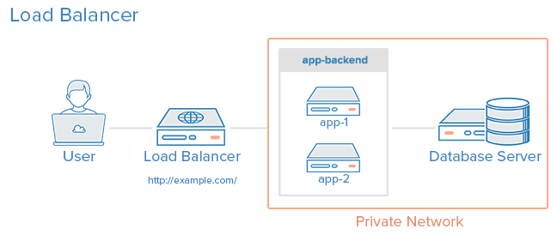
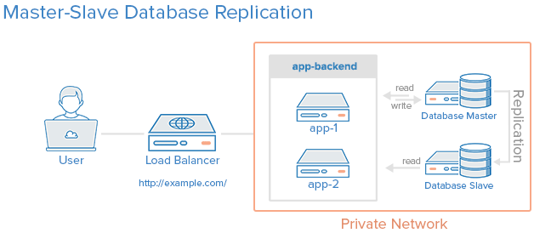

Slide 93
1. Everything On One Server
The entire environment resides on a single server. For a typical web application, that would include the web server, application server, and database server. A common variation of this setup is a LAMP stack, which stands for Linux, Apache, MySQL, and PHP, on a single server.
Use Case: Good for setting up an application quickly, as it is the simplest setup possible, but it offers little in the way of scalability and component isolation.
Pros:
Simple
Cons:
Application and database contend for the same server resources (CPU, Memory, I/O, etc.) which, aside from possible poor performance, can make it difficult to determine the source (application or database) of poor performance
Not readily horizontally scalable

Slide 94
2. Separate Database Server
The database management system (DBMS) can be separated from the rest of the environment to eliminate the resource contention between the application and the database, and to increase security by removing the database from the DMZ, or public internet.
Use Case: Good for setting up an application quickly but keeps application and database from fighting over the same system resources.

Slide 95
3. Load Balancer (Reverse Proxy)
Load balancers can be added to a server environment to improve performance and reliability by distributing the workload across multiple servers. If one of the servers that is load balanced fails, the other servers will handle the incoming traffic until the failed server becomes healthy again. It can also be used to serve multiple applications through the same domain and port, by using a layer 7 (application layer) reverse proxy.
Examples of software capable of reverse proxy load balancing: HAProxy, Nginx, and Varnish.
Use Case: Useful in an environment that requires scaling by adding more servers, also known as horizontal scaling.

Slide 96
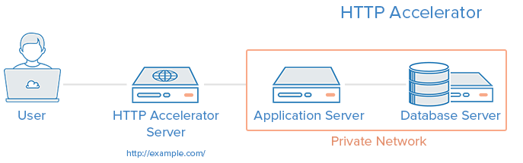
4. HTTP Accelerator (Caching Reverse Proxy)
An HTTP accelerator, or caching HTTP reverse proxy, can be used to reduce the time it takes to serve content to a user through a variety of techniques. The main technique employed with an HTTP accelerator is caching responses from a web or application server in memory, so future requests for the same content can be served quickly, with less unnecessary interaction with the web or application servers.
Examples of software capable of HTTP acceleration: Varnish, Squid, Nginx.
Use Case: Useful in an environment with content-heavy dynamic web applications, or with many commonly accessed files.

Slide 97
5. Master-Slave Database Replication
One way to improve performance of a database system that performs many reads compared to writes, such as a CMS, is to use master-slave database replication. Master-slave replication requires a master and one or more slave nodes. In this setup, all updates are sent to the master node and reads can be distributed across all nodes.
Use Case: Good for increasing the read performance for the database tier of an application.
Here is an example of a master-slave replication setup, with a single slave node:

Slide 98
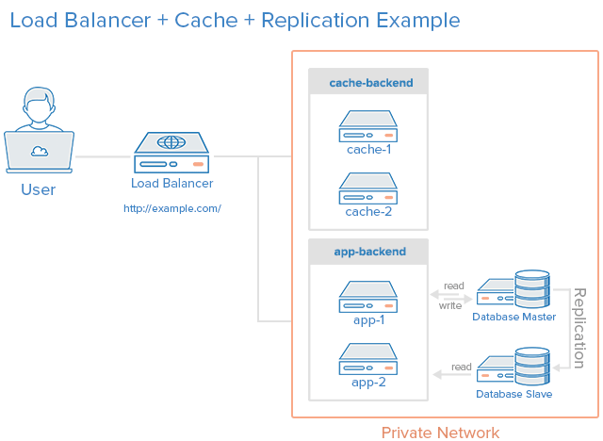
Example: Combining the Concepts

Slide 99
Example: Combining the Concepts (cont.)
Let's assume that the load balancer is configured to recognize static requests (like images, css, javascript, etc.) and send those requests directly to the caching servers, and send other requests to the application servers.
Here is a description of what would happen when a user sends a requests dynamic content:
The user requests dynamic content from http://example.com/ (load balancer)
The load balancer sends request to app-backend
app-backend reads from the database and returns requested content to load balancer
The load balancer returns requested data to the user
If the user requests static content:
The load balancer checks cache-backend to see if the requested content is cached (cache-hit) or not (cache-miss)
If cache-hit: return the requested content to the load balancer and jump to Step 7. If cache-miss: the cache server forwards the request to app-backend, through the load balancer
The load balancer forwards the request through to app-backend
app-backend reads from the database then returns requested content to the load balancer
The load balancer forwards the response to cache-backend
cache-backend caches the content then returns it to the load balancer
The load balancer returns requested data to the user
This environment still has two single points of failure (load balancer and master database server), but it provides the all of the other reliability and performance benefits that were described in each section above.

Slide 100
Example: IoT Smart Weather

Slide 101
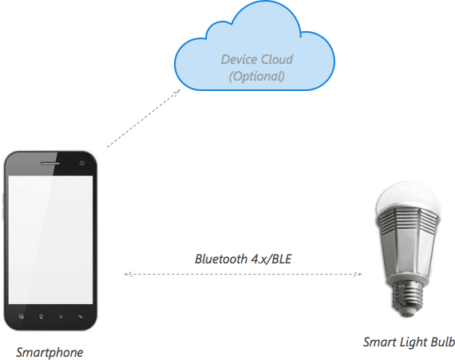
Example: High Level Architecture for a Connected Smart Light Bulb
There is several possible way to connect to the Cloud IoT
1st way of network cloud configuration is called - Smartphone centric
architecture

Slide 102
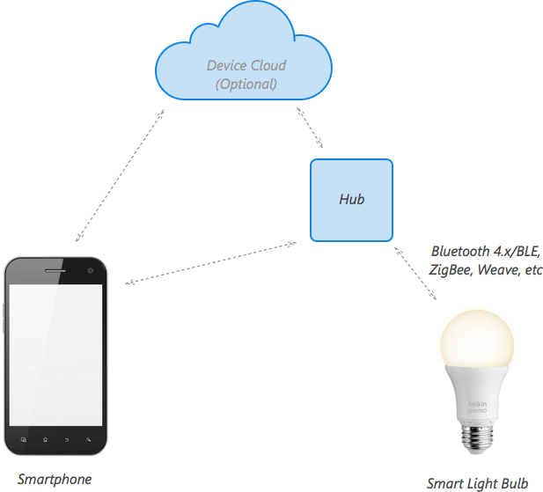
cont.
2nd way of network cloud configuration is called –
Hub-centric architecture
(with or without cloud)

Slide 103
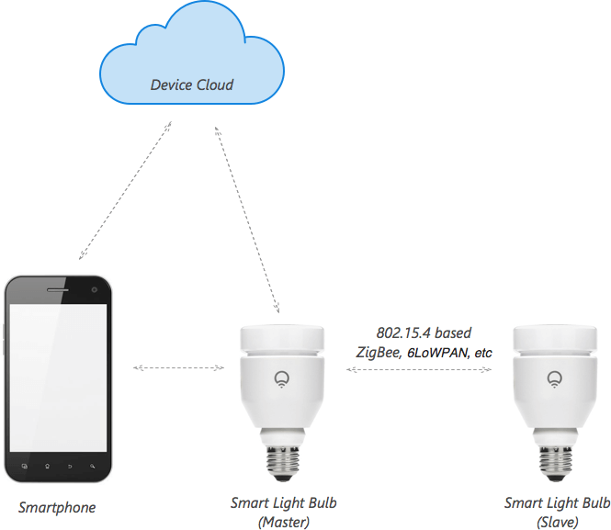
cont.
3rd way of network cloud configuration is called - Cloud-centric architecture
(without hub)

Slide 104
Key points
A software architecture is a description of how a software system is organized.
Architectural design decisions include decisions on the type of application, the distribution of the system, the architectural styles to be used.
Architectures may be documented from several different perspectives or views such as a conceptual view, a logical view, a process view, and a development view.
Architectural styles & patterns are a means of reusing knowledge about generic system architectures. They describe the architecture, explain when it may be used and describe its advantages and disadvantages.

Slide 105
Key points
Models of application systems architectures help us understand and compare applications, validate application system designs and assess large-scale components for reuse.

Slide 106
References
https://www.digitalocean.com/community/tutorials/5-common-server-setups-for-your-web-application
https://www.eventhelix.com/RealtimeMantra/FaultHandling/reliability_availability_basics.htm#.WMugv7W2zBL
https://docs.microsoft.com/en-us/previous-versions/msp-n-p/ee658117(v=pandp.10)?redirectedfrom=MSDN#ServiceOrientedStyle
https://www.processimpact.com/articles/qualreqs.pdf
https://reqexperts.com/2012/10/09/using-the-correct-terms-shall-will-should/
https://www.ibm.com/developerworks/rational/library/2774.html

